Slide 1
Microprocessor system
Moise Madalina
Alexa Alexandru

Slide 2

Fingeprint integration with raspberry pi

Slide 3

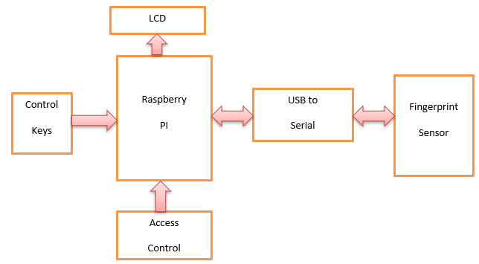
System architecture

Slide 4
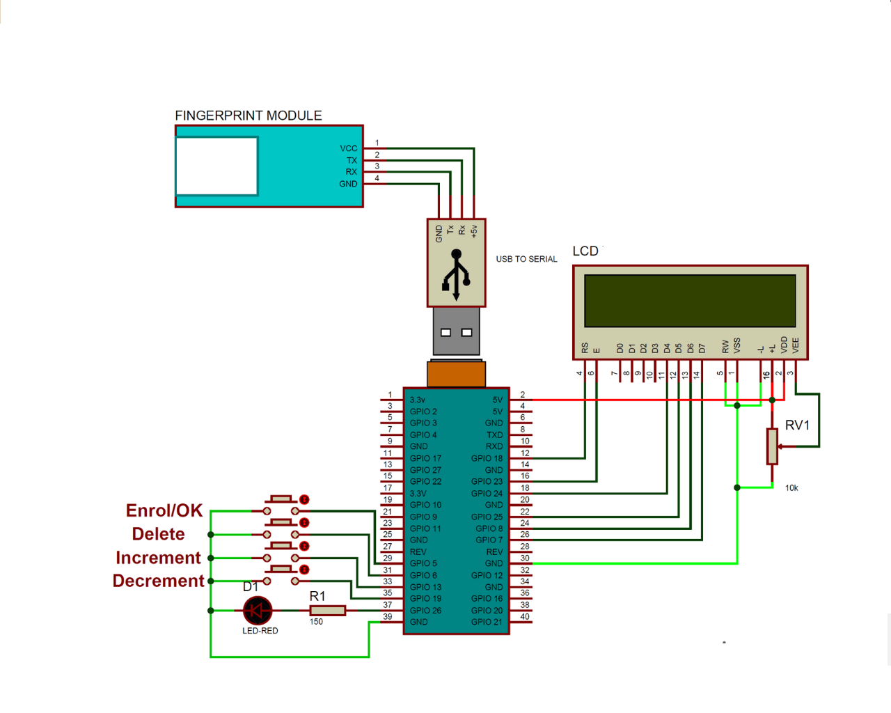
Hardware design

Slide 5
Software design
import time
from pyfingerprint.pyfingerprint import PyFingerprint
import RPi.GPIO as gpio
from firebase import firebase
Begin()
startMessagesToLcd
firebaseSettings
Lcdcmd()
Lcdwrite()
Lcdclear()
Lcdprint()
PyFingerprint()
enrollFinger()
searchFinger(fa)
deleteFinger()

Slide 6
Results

Slide 7

Conclusions Future works

